Slide 1
INTERNITY FOUNDATION
PRESENTATION ON BIT MASKING,RED BLACK TREE, HEAPS
Presented by:
Lipika Chugh
Aman Goyal
Akash Sharma
Harshit Garg

Slide 2
Bit Masking
Bit masking is a method of manipulating bits from a binary sequence.
Bit masking is basically done using Bitwise operators,like:
Bitwise AND Operator (&)
Bitwise OR Operator (|)
Bitwise NOT Operator (!)
Bitwise XOR Operator (^)
Bitwise Left Shift (<<)
Bitwise Right Shift (>>).
Mask in Bitmask means hiding something. Bitmask is nothing but a binary number that represents something.

Slide 3
Some uses of bit masking like:
Dividing a number by a power of 2
Like for x=38 in binary:100110
100110>>1=010011 which is 19 (38/2)
100110>>2=001001 which is 9 (38/4) and so on.
Multiplying a number by a power of 2
For x=9,which is 1001
1001<<1=10010 which is 18 (9*2)
1001<<2=100100 which is 36 (9*4)
Setting a particular bit to be as 1
For x=10010101,if we want to set the 3rd bit as 1
Then we OR it with 00100000.
So we get 10110101
Data Structures

Slide 4
Toggle the nth bit of a number
For x=10101010110,if we want to change the 5th bit
Then we XOR it with 00001000000
So we get 10100010110
Assign some bits as 0
Foe x=1010101010,and we want to change the 5th,7th bit as 0
Then we AND it with 111101011111
So we get 1010000010.

Slide 5
Other applications of Bit masking
Uppercase English Alphabet to Lowercase:
ch |= ' ';
A -> 01000001 a -> 01100001
B -> 01000010 b -> 01100010
C -> 01000011 c -> 01100011
. .
. .
Z -> 01011010 z -> 01111010
ch = ‘A’ (01000001)
mask = ‘ ‘ (00100000)
ch | mask = ‘a’ (01100001)

Slide 6
Converting Lowercase to uppercase
ch &= '_’ ;
A -> 01000001 a -> 01100001
B -> 01000010 b -> 01100010
C -> 01000011 c -> 01100011
. .
. .
Z -> 01011010 z -> 01111010
ch = ‘a’ (01100001)
mask = ‘_ ‘ (11011111) (95)
ch & mask = ‘A’ (01000001)

Slide 7
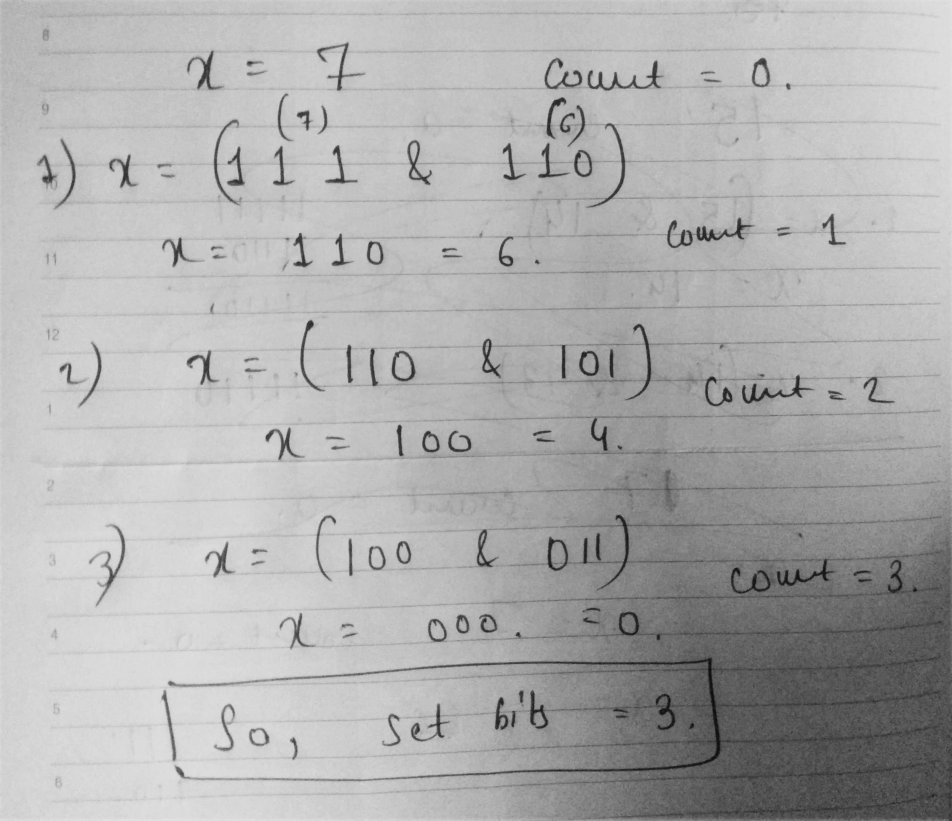
Count set bits in integer (Brian Kernighan’s Algorithm)
int countSetBits(int x) { int count = 0; while (x) { x &= (x-1); count++; } return count; }

Slide 8
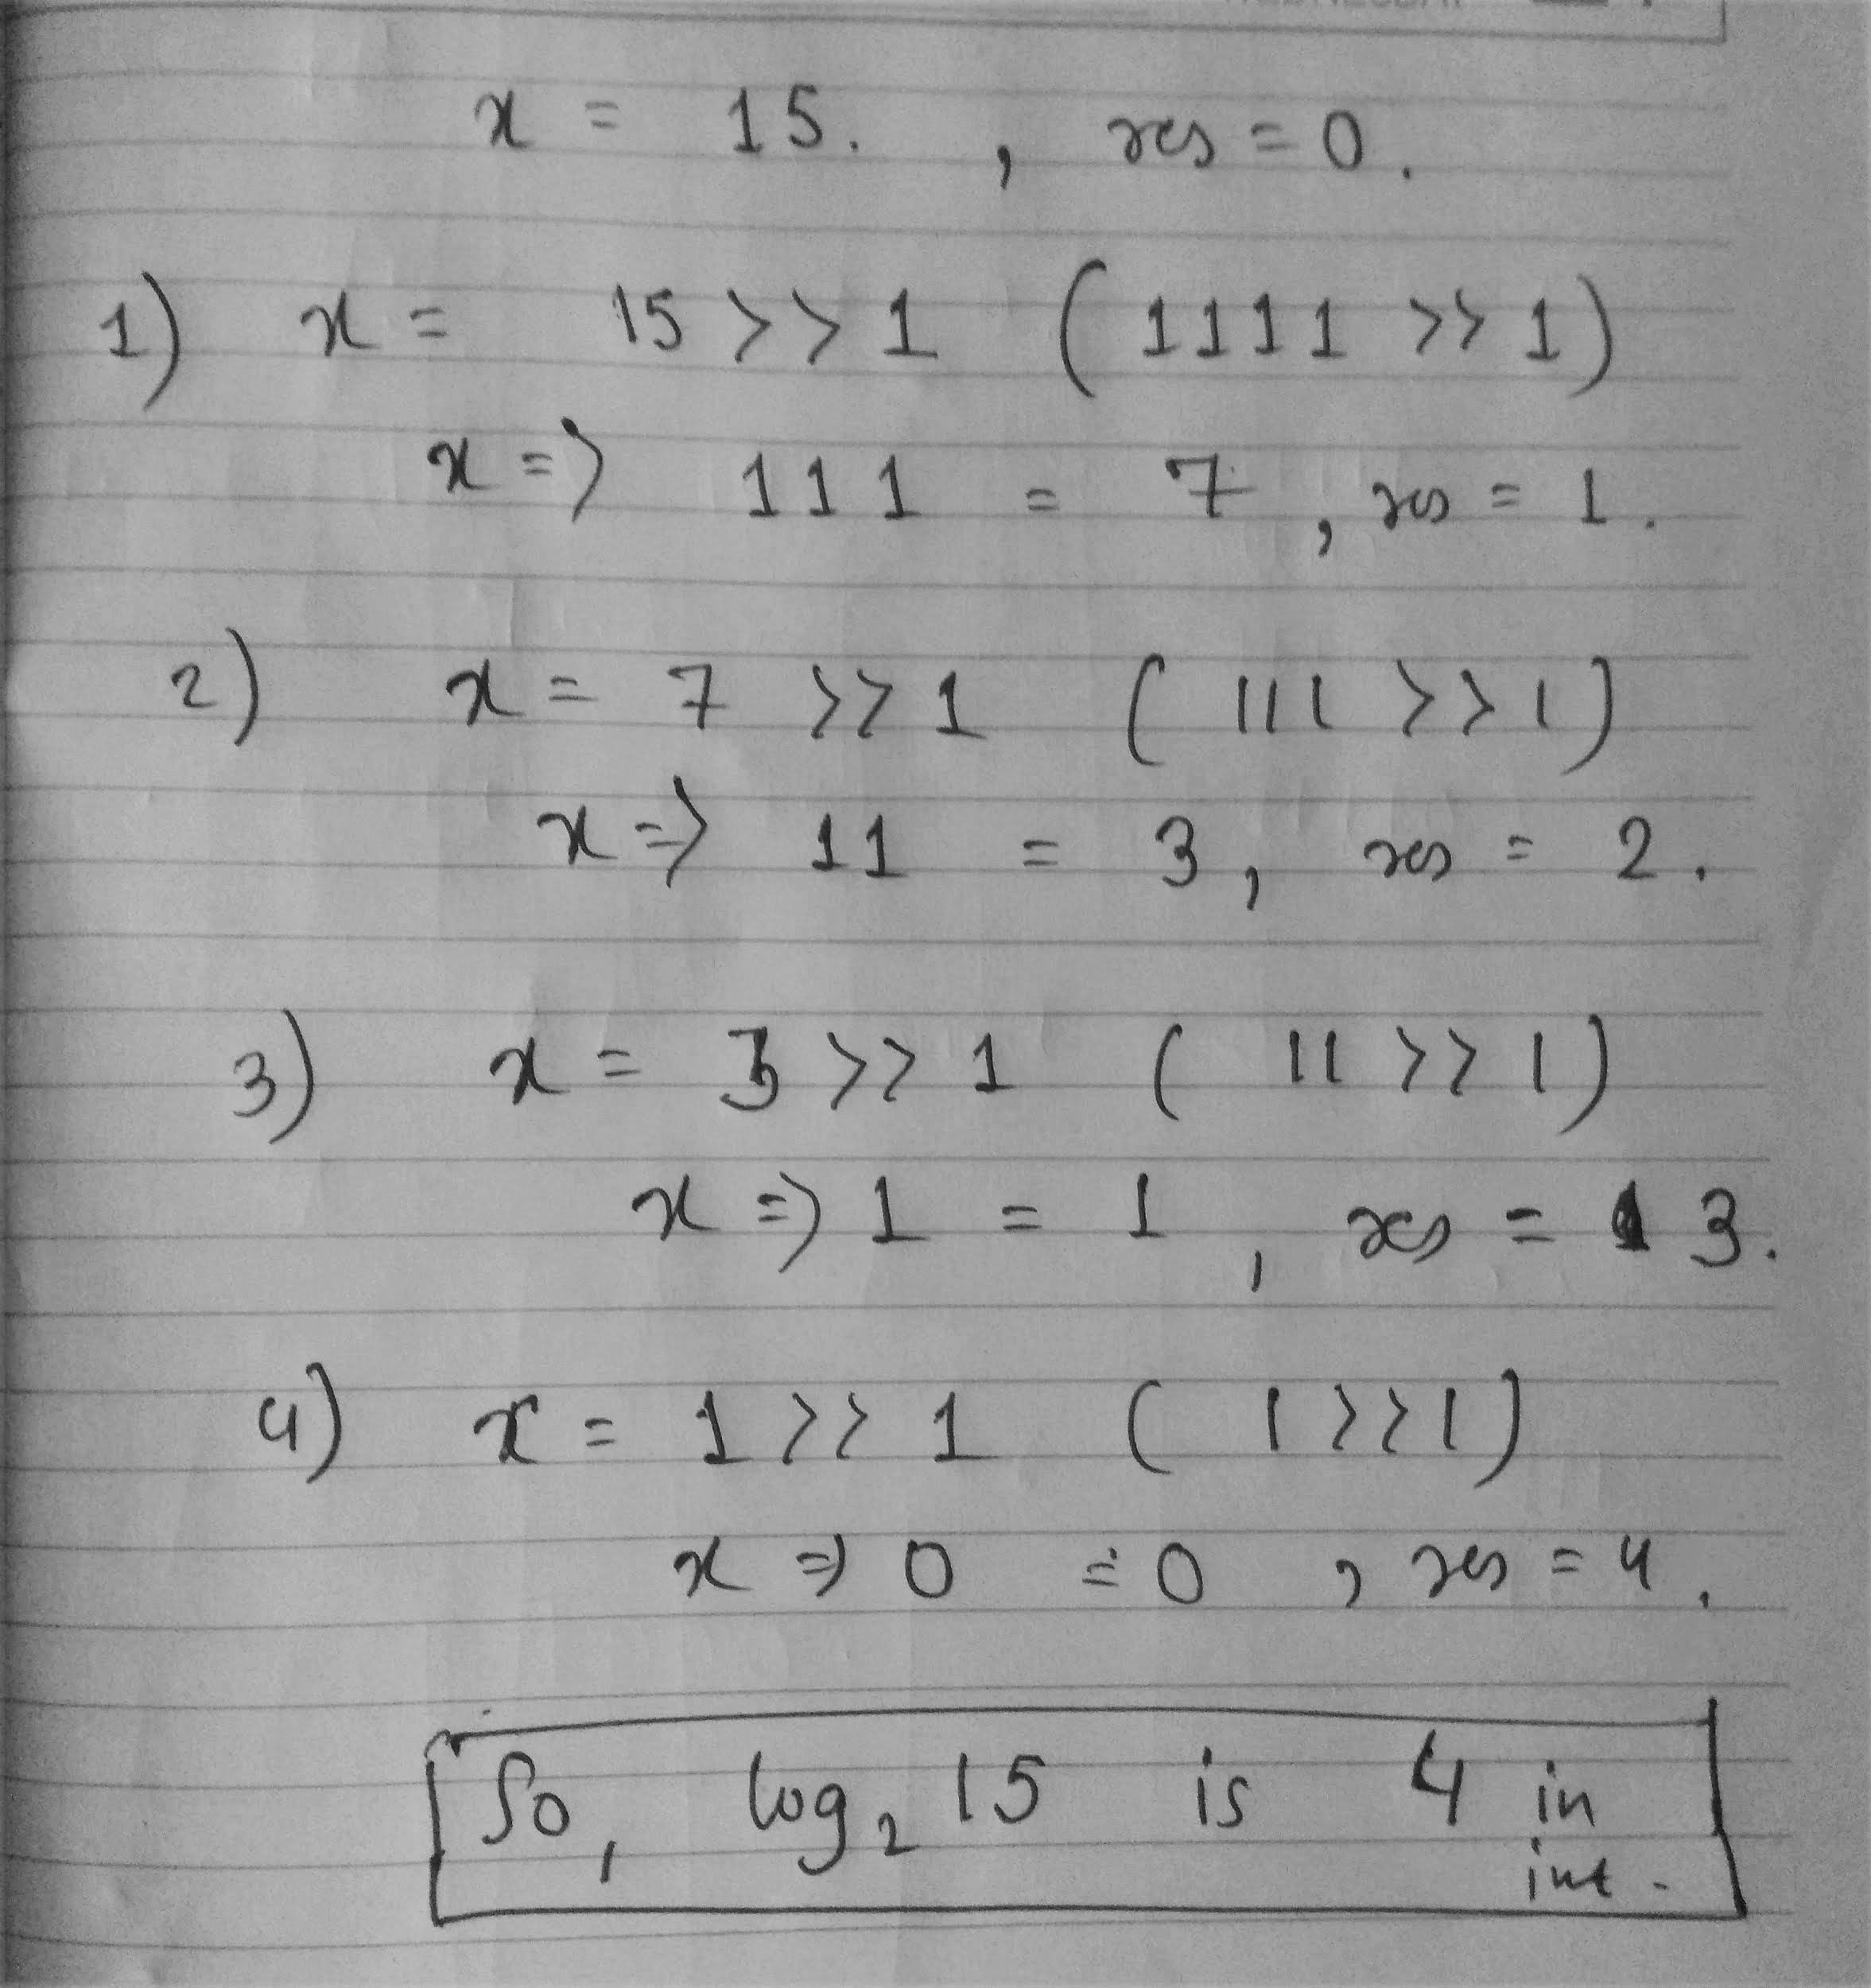
Find log base 2 of 32 bit integer
int log2(int x)
{
int res = 0;
while (x >>= 1)
res++;
return res;
}

Slide 9
Red Black Trees
Data Structures

Slide 10
Problem with Binary Search Tree
Binary Search Tree is fast in insertion and deletion etc. when balanced.
Time Complexity of performing operations (e.g. searching , inserting , deletion etc) on binary search tree is O(logn) in best case i.e when tree is balanced.
And on the other hand performance degrades from O(logn) to O(n) when tree is not balanced.
Basic binary search trees have three very nasty degenerate cases where the structure
stops being logarithmic and becomes a glorified linked list.
The two most common of these degenerate cases is ascending or descending sorted order (the third is outside-in alternating order).

Slide 11
Problem with Binary Search Tree
1
2
3
4
6
5
4
3
9
2
7
5
6
Ascending order
Descending Order
Alternating Order

Slide 12
Red Black Tree
A red-black tree is a balanced binary search tree with one extra bit of storage per node:
its color, which can be either Red or Black.
By constraining the node colors on any simple path from the root to a leaf, red-black trees ensure that no such path is more than twice as long as any other, so that the tree is approximately balanced.
Each node of the tree now contains the attributes color, key, left, right, and p.
If a child or the parent of a node does not exist, the corresponding pointer attribute of the node contains the value NIL.

Slide 13
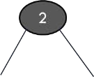
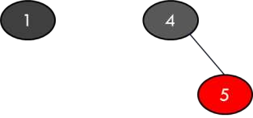
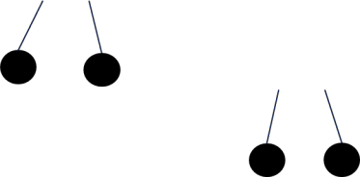
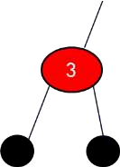
Properties of Red Black Tree
A red-black tree is a binary tree that satisfies the following red-black properties:
Every node is either red or black.
The root is black.
Every leaf (NIL) is black.
If a node is red, then both its children are black.
For each node, all simple paths from the node to descendant leaves contain the same number of black nodes.

Slide 14
Red Black Tree (Rotations)
The search-tree operations TREE-INSERT and TREE-DELETE, when run on a red black tree with n keys, take O(log n)time. Because they modify the tree, the result may violate the red-black properties.
To restore these properties, we must change the colors of some of the nodes in the tree and also change the pointer structure.
We change the pointer structure through rotation, which is a local operation in a search tree that preserves the binary-search-tree property.
There are two kinds of rotations : left rotations and right rotations.

Slide 15
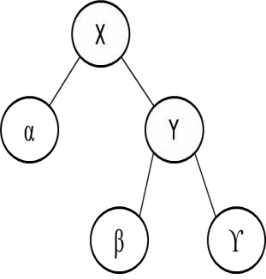
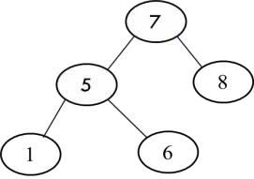
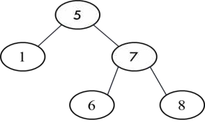
LEFT ROTATION
When we do a left rotation on a node x, we assume that its right child y is not null ;x may be any node in the tree whose right child is not null.
Y
X
ϒ
α
β

Slide 16
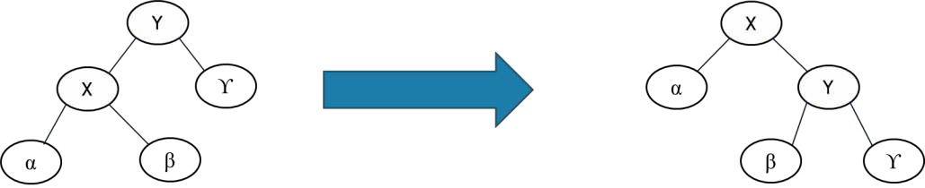
RIGHT ROTATION

Slide 17
Insertion
We can insert a node into an n-node red-black tree in O(logn) time.
To do so, we use a slightly modified version of the TREE-INSERT procedure to insert node into the tree T as if it were an ordinary binary search tree.
Then we color it to red.
To guarantee that the red-black properties are preserved, we then call an auxiliary procedure RB-INSERT FIXUP to recolor nodes and perform rotations.

Slide 18
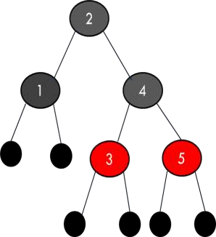
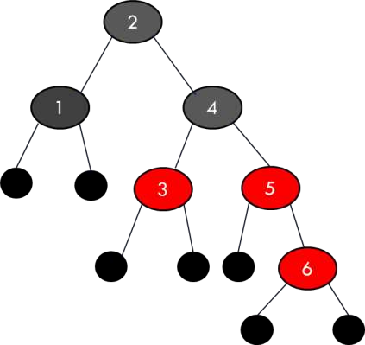
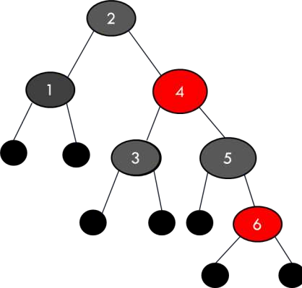
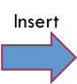
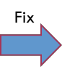
Insertion

Slide 19
Insertion
RB-INSERT(T, z)
y ← T.nil
x ← T.root
while x ≠ T.nil
y = x
if z.key < x.key
then x ← x.left
else x ← x.right
z.p = y
if y = T.nil
then T.root ← z
else if z.key< y.key
then y.left ← z
else y.right ← z
z.left ← T.nil
z.right ← T.nil
z.color← RED
RB-INSERT-FIXUP(T, z)

Slide 20
IInsertion
The procedures TREE-INSERT and RB-INSERT differ in four ways..
First, all instances of NIL in TREE-INSERT are replaced by T.nil.
Second, we set z.left and z.right to T. nil in lines 14–15 of RB-INSERT, in order to
maintain the proper tree structure.
Third, we color z red in line 16.
Fourth, because coloring z.red may cause a violation of one of the red-black properties, we call RB-INSERT-FIXUP(T,z) in line 17 of RB-INSERT to restore the red-black properties

Slide 21
Insertion
To understand how RB-INSERT-FIXUP works, we shall break our examination of the code into three major steps.
First, we shall determine what violations of the red-black properties are
introduced in RB-INSERT when node z is inserted and colored red.
Second, we shall examine the overall goal of the while loop in lines 1–15.
Finally, we shall explore each of the three cases within the while loop’s body and see how they accomplish the goal.

Slide 22
Insertion
The while loop in lines 1–15 maintains the following three-part invariant.
At the start of each iteration of the loop,
Node z is red.
If z.p is the root, then z.p is black.
If there is a violation of the red-black properties , there is at most one violation, and it is of either property 2 or property 4. If there is a violation of property 2, it occurs because z is the root and is red. If there is a violation of property 4, it occurs because both z and z.p are red.

Slide 23
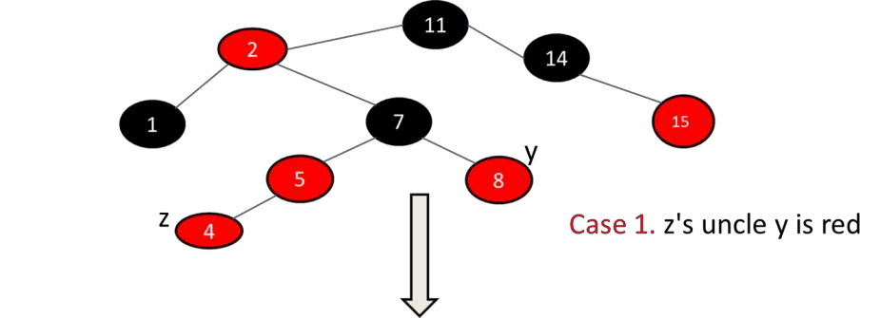
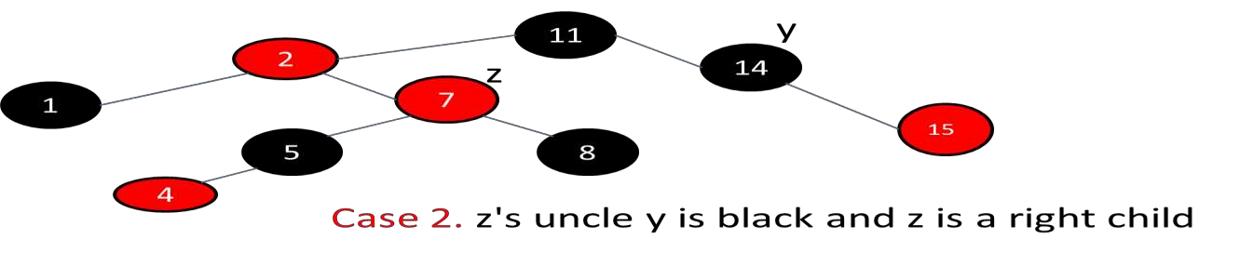
Insertion

Slide 24
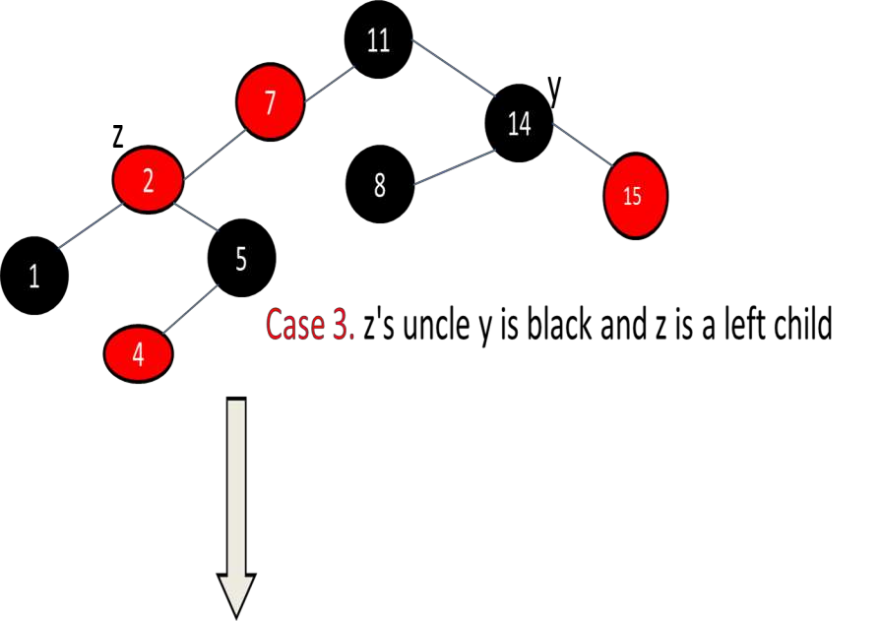
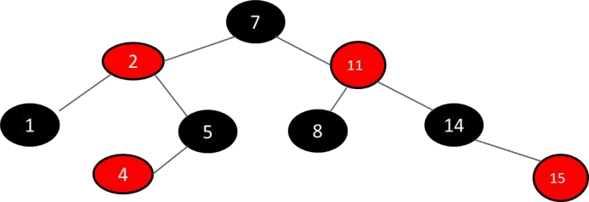
Insertion

Slide 25
Heaps
Heap is a data structure which is similar to binary tree with the two properties:
Complete Binary Tree
Heap Order Property
We use heaps in order to resolve the issues with a balanced BST, i.e., maintenance of balancing factor after every insertion or deletion and storing the many child pointers.

Slide 26
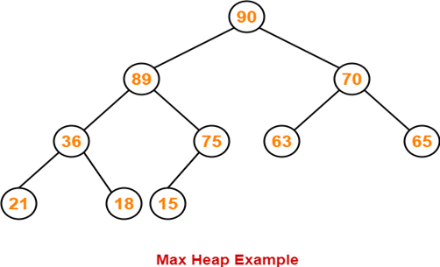
•A binary heap is a complete binary tree which satisfies the heap ordering property. The ordering can be one of two types:
•the min-heap property: the value of each node is greater than or equal to the value of its parent, with the minimum-value element at the root.
•the max-heap property: the value of each node is less than or equal to the value of its parent, with the maximum-value element at the root.

Slide 27
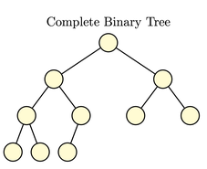
Complete binary tree– if not full, then the only unfilled level is filled in from left to right.

Slide 28
The heap property of a tree is a condition that must be true for the tree to be considered a heap.
Min-heap property: for min-heaps, requires A[parent(i)] <= A[i]
So, the root of any sub-tree holds the least value in that sub-tree.
Max-heap property: for max-heaps, requires A[parent(i)] >= A[i]
The root of any sub-tree holds the greatest value in the sub-tree.

Slide 29
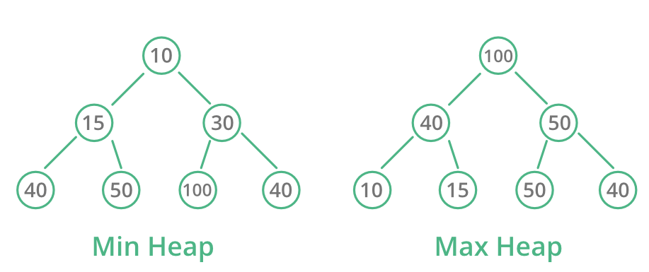

Slide 30
Max Heap Construction Algorithm
Step 1 − Create a new node at the end of heap.
Step 2 − Assign new value to the node.
Step 3 − Compare the value of this child node with its parent.
Step 4 − If value of parent is less than child, then swap them.
Step 5 − Repeat step 3 & 4 until Heap property holds.

Slide 31
Operations on Max Heap
•Finding Maximum
•Insertion
•Deletion of maximum element

Slide 32
Finding Maximum Value Operation in Max Heap
•Finding the node which has maximum value in a max heap is very simple.
•In a max heap, the root node has the maximum value than all other nodes. So, directly we can display root node value as the maximum value in max heap.

Slide 33
Insertion Operation in Max Heap
•Step 1 - Insert the newNode as last leaf from left to right.
•Step 2 - Compare newNode value with its Parent node.
•Step 3 - If newNode value is greater than its parent, then swap both of them.
•Step 4 - Repeat step 2 and step 3 until newNode value is less than its parent node (or) newNode reaches to root.

Slide 34
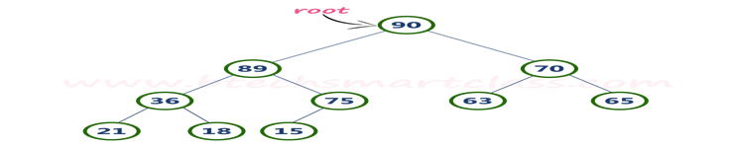
Example: Insert 85
•Step 1: Insert the newNode with value 85 as last leaf from left to right. newNode is added as a right child of node with value 75.
•Step 2 - Compare newNode value (85) with its Parent node value (75). That means 85 > 75
•Step 3 - Here newNode value (85) is greater than its parent value (75), then swap both of them.
•Step 4 - Now, again compare newNode value (85) with its parent node value (89). Here, newNode value (85) is smaller than its parent node value (89). So, we stop insertion process.

Slide 35
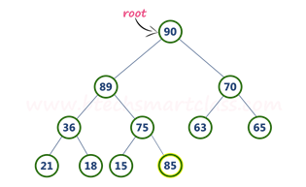
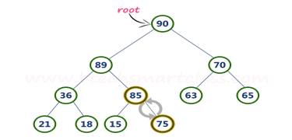


Slide 36
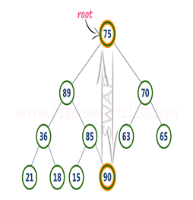
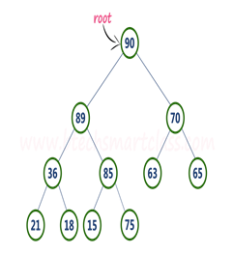

Deletion of max in Max Heap
Step 1 - Swap the root node with last node in max heap
Step 2 - Delete last node.
Step 3 - Now, compare root value with its left child value and right child value
Step 4 - Copy larger child up and go down one level.
Step 5- Done if both children are <= item or reached a leaf node

Slide 37
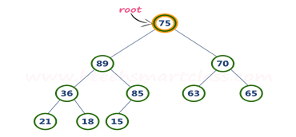
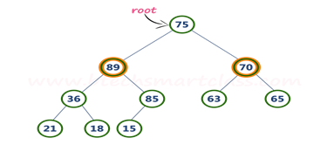
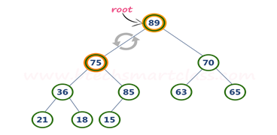

•Step 3 - Compare root node (75) with its left child (89) and right chile(70). Here, left child value (89) is larger than its right sibling (70), So, swap root (75) with left child (89).

Slide 38
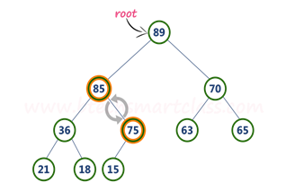
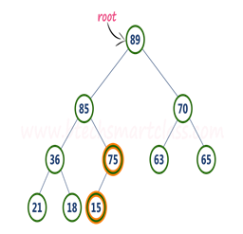
•Step 4 - Now, again compare 75 with its left child (36) and right child(85. Here, node with value 75 is smaller than its right child (85). So, we swap both of them.)
•Step 5 - Now, compare node with value 75 with its left child (15). Here, node with value 75 is larger than its left child (15) and it does not have right child. So we stop the process.

Slide 39
Heap Sort
Heaps can be used in sorting an array.
In max-heaps, maximum element will always be at the root. Heap Sort uses this property of heap to sort the array.
Working of Heap Sort:
Consider an array Arr which is to be sorted using Heap Sort.
Initially build a max heap of elements in Arr.
The root element that is Arr[1], will contain maximum element of Arr. After that swap this element with the last element of Arr and heapify the max heap excluding the last element which is already in its correct position and the decrease the length of heap by one.
Repeat step 2, until all the elements are in their correct position.

Slide 40
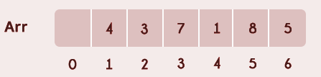
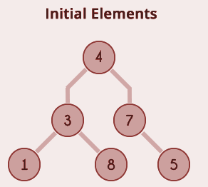
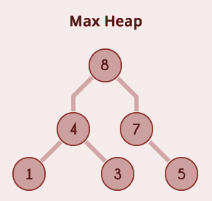
Example for Heap Sort
Consider the following unsorted array Arr which is having 6 elements.
Now max heap is built.

Slide 41
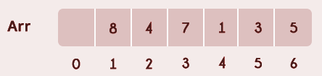
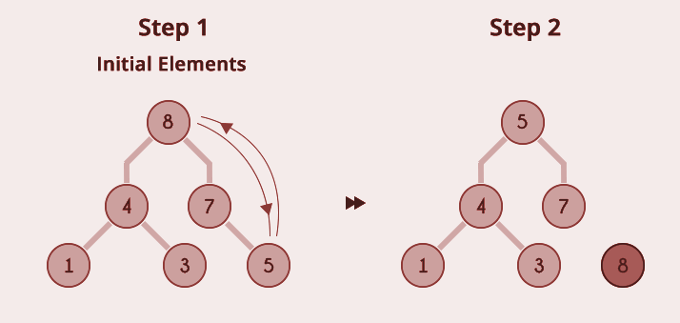
After building max heap the elements in the Arr will be:
Step 1: 8 is swapped with 5.
Step 2: 8 is disconnected from heap as 8 is in correct position now.

Slide 42
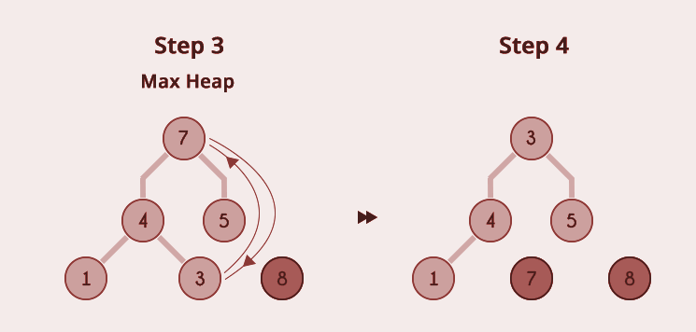
Step 3: Max-heap is created and 7 is swapped with 3.
Step 4: 7 is disconnected from heap.

Slide 43
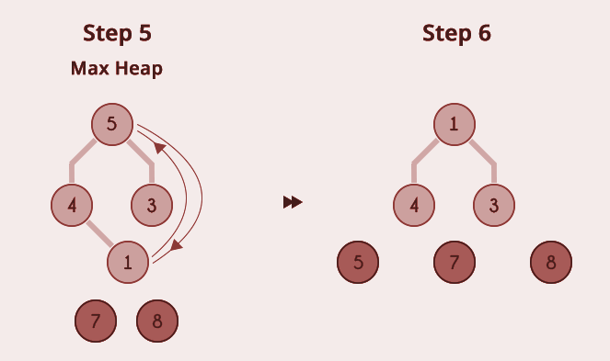
Step 5: Max heap is created and 5 is swapped with 1.
Step 6: 5 is disconnected from heap.

Slide 44
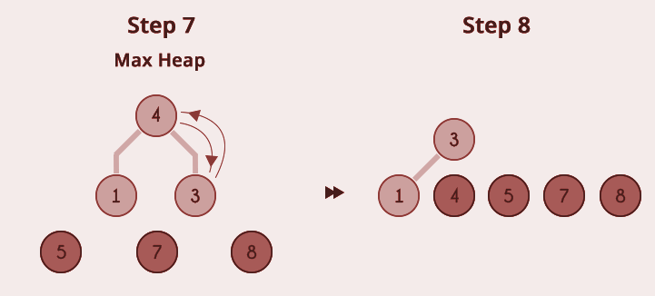
Step 7: Max heap is created and 4 is swapped with 3.
Step 8: 4 is disconnected from heap.

Slide 45
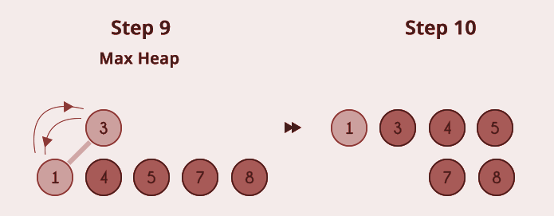
Step 9: Max heap is created and 3 is swapped with 1.
Step 10: 3 is disconnected.

Slide 46
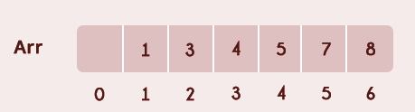
After all the steps, we will get a sorted array as shown in the figure below.

Slide 47
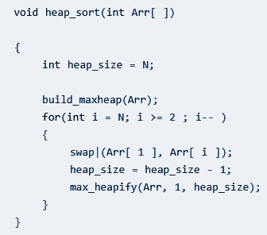
Implementation & Time Complexity of Heap Sort
Here’s the pseudo code for the implementation of heap sort:
Complexity:
Heap Sort has O(nlog n) time complexities for all the cases ( best case, average case, and worst case).
max_heapify has complexity O(logN) , build_maxheap has complexity O(N) and we run max_heapify N−1 times in heap_sort function, therefore complexity of heap_sort function is O(NlogN).

Slide 48
Heap Sort Applications
Systems concerned with security and embedded systems such as Linux Kernel use Heap Sort because of the O(n log n) upper bound on Heapsort's running time and constant O(1) upper bound on its auxiliary storage.
Although Heap Sort has O(n log n) time complexity even for the worst case, it doesn't have more applications ( compared to other sorting algorithms like Quick Sort, Merge Sort ). However, its underlying data structure, heap, can be efficiently used if we want to extract the smallest (or largest) from the list of items without the overhead of keeping the remaining items in the sorted order. For e.g Priority Queues.

